Slide 1



The Rise of Kali Workshop
ROK{L3ts_B3g1n}

Slide 2

CTF BRIEF:
OSINT 101

Slide 3
What Is OSINT?
Open-Source Intelligence is a way to collect and analyze the information that has been released to the public.
It can be used to understand the information of the target whether it’s the device details or personal Information

Slide 4
SO, WHAT DO YOU NEED TO LOOK FOR?

Slide 5
Finding Out:
The Target’s Personal Information
Pre & Post Activity
Other Social Medias
Suspicious data
The Target Systems’ Information
Device Operating System
Open ports
etc

Slide 6

OSINT to Gather Target’s Info

Slide 7


Slide 8
Top Used OSINT Tools
Sherlock
Maltego
Shodan
Recon-Ng

Slide 9
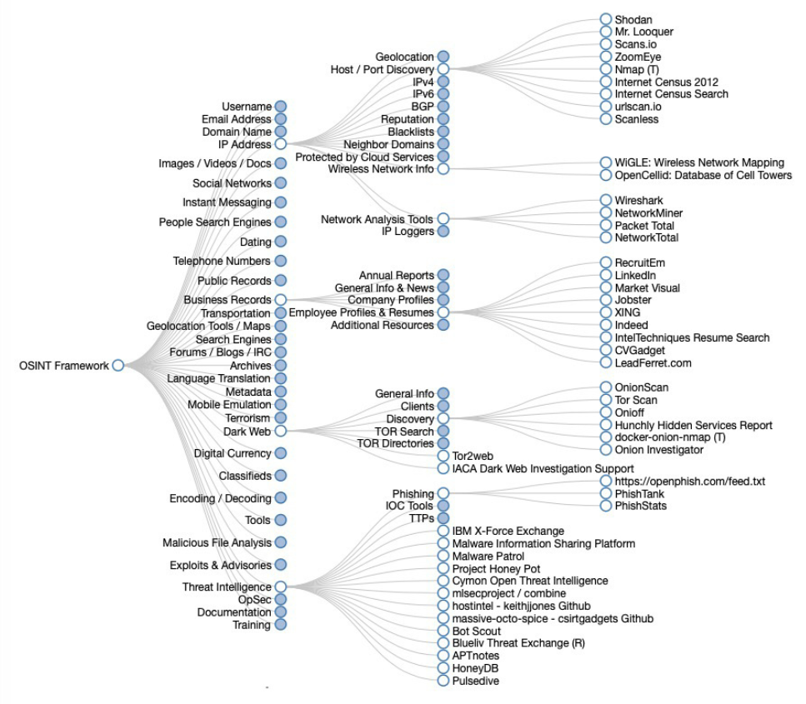
Source: osintframework.com

Slide 10

Disclaimer
Kids, don’t start doing illegal stuff thanks, I will whack u if u abuse these knowledge🙂

Slide 11
Google OSINT aka Google Dorking
Abusing Google search engine by injecting queries
Find information inaccessible through regular google searching
https://www.exploit-db.com/google-hacking-database
https://gist.github.com/sundowndev/283efaddbcf896ab405488330d1bbc06

Slide 12

LET’S GET TO WORK!

Slide 13
CTF BRIEF:
WEB 101

Slide 14
WEB APPLICATION EXPLOIT:
Exploit vulnerabilities within web-based applications
Common languages:
JS
PHP
Python
And also all their frameworks…

Slide 15
TOOLS:
Burpsuite
Gobuster

Slide 16
LET’S GET TO WORK!

